Slide 1


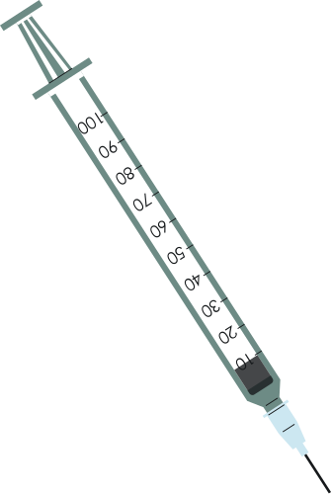




MedTrove
Aliza Ibrahim 21i-0470
Kissa Zahra 21i-0572
Hamna Sadia Rizwan 21i-0603
Supervisor: Mr. Bilal Khalid Dar
Co-Supervisor: Ms. Zoya Mahboob

Slide 2













Overview
Problem Statement
Existing
Systems
Process Flow
Problem Solution
Scope
Prototype
Goals
Tools
&
Technologies
Timeline
&
Work Division
1

Slide 3


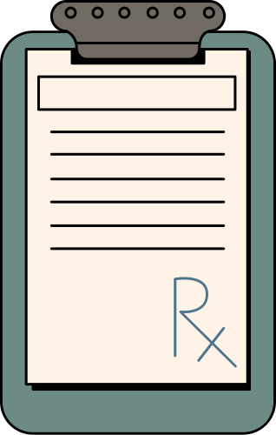
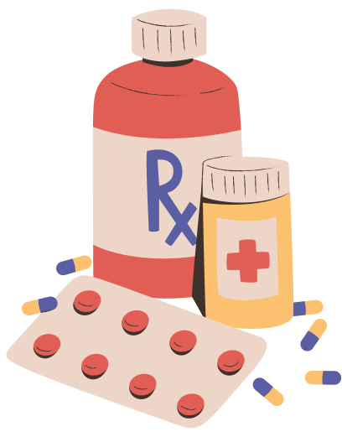

Problem Statement
Medication prices surged by up to 200% since 2019.
High prevalence of diabetes (26.7%) and heart diseases (29% of deaths).
Corruption in healthcare exacerbates affordability issues.
40% of Pakistanis live below the poverty line as of 2024.
2

Slide 4
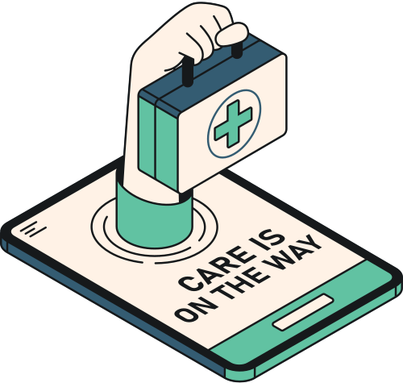
Problem Solution
MedTrove Mobile Application:
Search + Alternatives
Medibot
Online Doctor Consultations
3

Slide 5





Existing Systems
Dawaii.com
Drugs.com
Pharmapedia
4

Slide 6

Goals
Streamlined medication management
Informed decision making
Personalised health insights
5

Slide 7

Scope
Cross-Platform Application
User Account Management
Medication Search
Shopping Cart and Checkout
Drug Interaction Checker
Medibot
Online Consultations
Donations
6

Slide 8
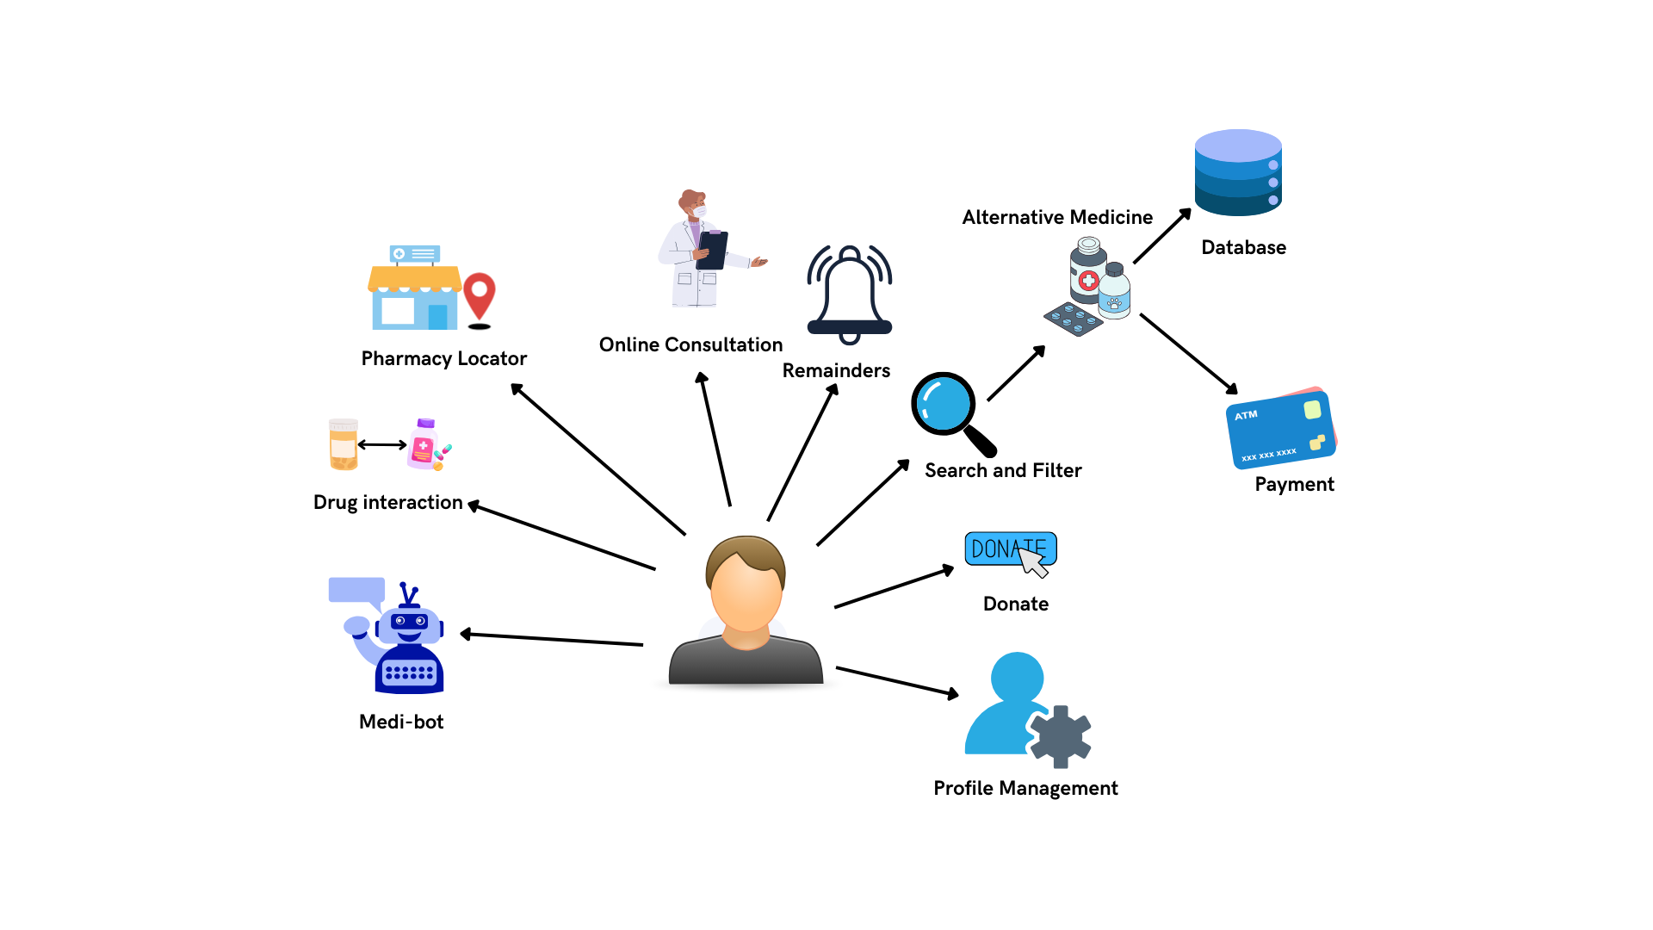
Process Flow
7

Slide 9
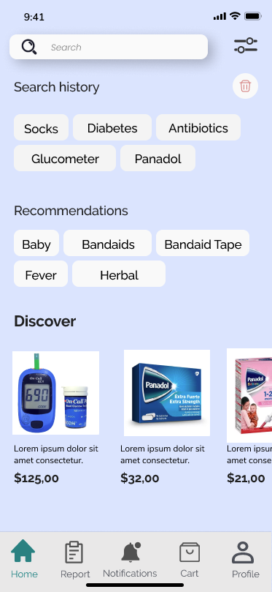
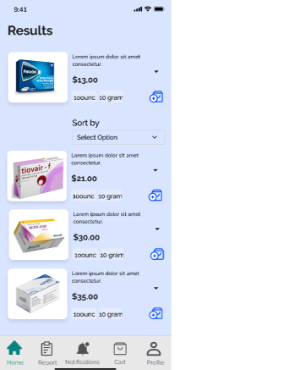
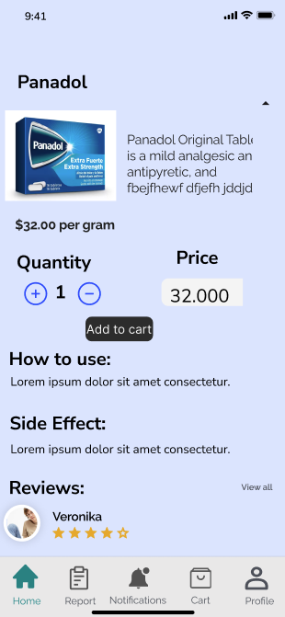
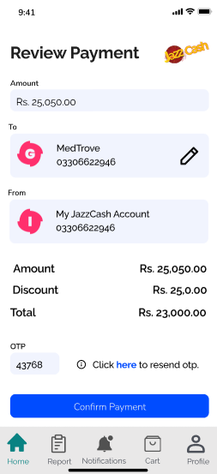
Prototype
Search Medicine
Alternative Medicine
Medicine Infomation
Payment
8

Slide 10

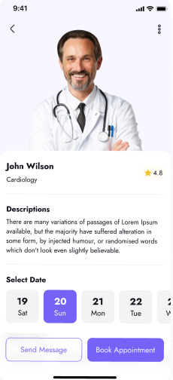
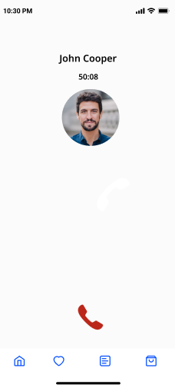
Prototype
Online Consultation
Doctor informatiion
Online Calls
9

Slide 11
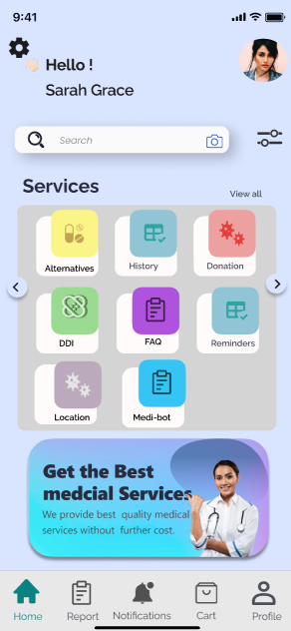
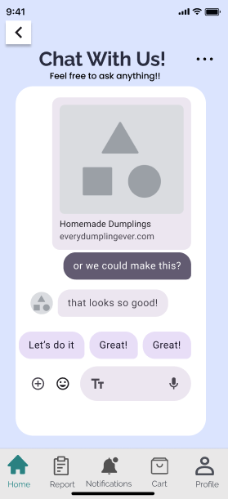
Prototype
10
Home page
MediBot

Slide 12







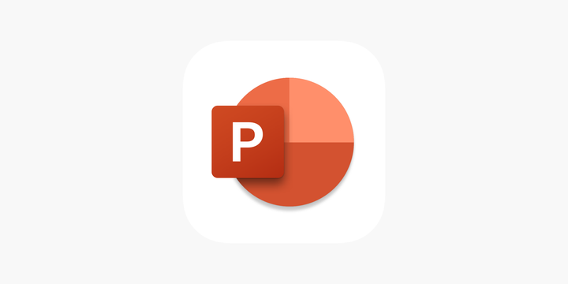



Tools and Technologies
Python
MERN
HTML/CSS/JS
Github
VS code
Android Studio
Figma
Trello
MS excel
Word
Powerpoint
11

Slide 13
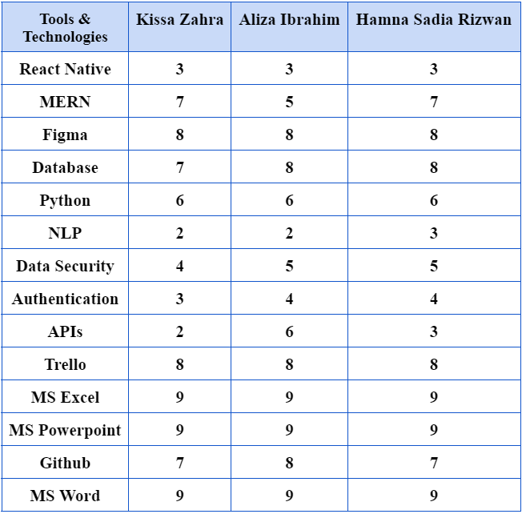
Skill Assessment
12

Slide 14
TASK / PROCESS
Iteration 1
Iteration 2
Iteration 3
Iteration 4
T
I
M
E
L
I
N
E
AUG - OCT
NOV - JAN
FEB- APR
MAY - JUL
UI/UX implementation
Learning
Identify Dataset
Substitute Drug Identifier
Drug search & Recommendation
Pharmacy Locator
Video Processing
Payment
Donation
Medi-Bot
Online Consultation
Drug interaction Checker
Medication Reminder
Profile Management
13
Testing & Debugging

Slide 15

References
[1] F. Durrani, “Increase in drug prices highest in last 40 years,” 8 April 2019. [Online]. Available: https://www.thenews.com.pk/print/454864-increase-in-drug-prices-highest-in-last-40-years. [Accessed 12 July 2024].
[2] “Govt approves increase in prices of 146 essential life-saving medicines,” 1 February 2024. [Online]. Available: https://www.dawn.com/news/1810395. [Accessed 12 July 2024].
[3] “The increasing rate of diabetes in Pakistan: A silent killer,” [Online]. Available: https://www.ncbi.nlm.nih.gov/pmc/articles/PMC9289249/. [Accessed 12 July 2024].
[4] I. Junaidi and R. Zakaria, “'47 people die of heart attack every hour in Pakistan',” 30 September 2021. [Online]. Available: https://www.dawn.com/news/1649189. [Accessed 12 July 2024].
[5] “PAKISTAN: Implementing an Ambitious, Credible and Clearly Communicated Economic Reform Plan Critical for Robust Recovery, Poverty Reduction, says World Bank,” 2 April 2024. [Online]. Available: https://www.worldbank.org/en/news/press-release/2024/04/01/pakistan-implementing-an-ambitious-credible-and-clearly-communicated-economic-reform-plan-critical-for-robust-recovery-p. [Accessed 12 July 2024].
[6] Dawn, “Big Pharma and Physicians,” 6 October 2008. [Online]. Available: https://www.dawn.com/news/845158/big-pharma-and-physicians.
14

Slide 16


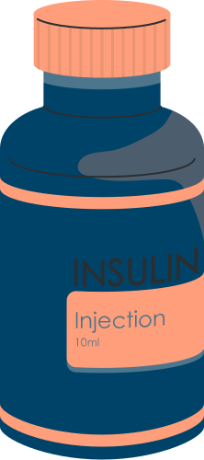
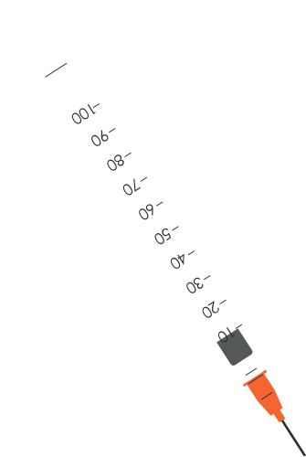

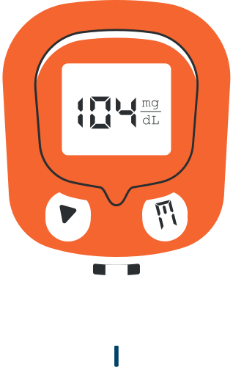
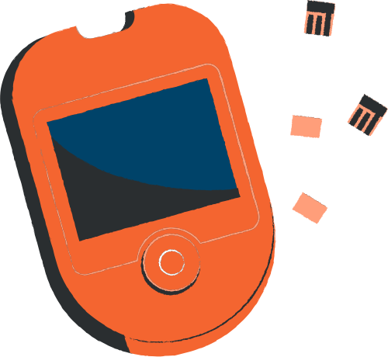
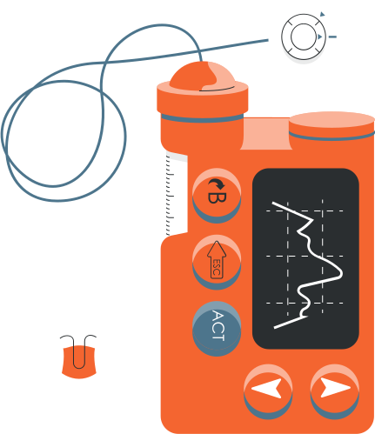

Thank You!
Any Questions?

Slide 17

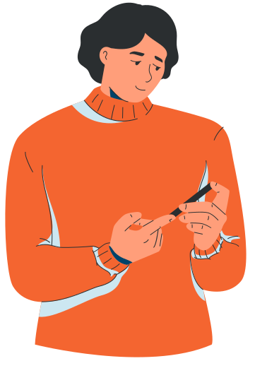

What are the signs and symptoms of diabetes?

Slide 18
Technologies

Slide 19


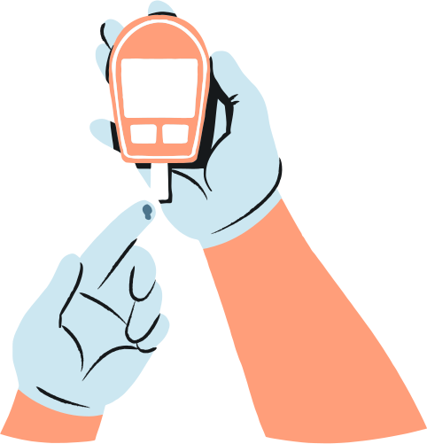
What are high blood sugar levels?
Explain high blood sugar levels.

Slide 20


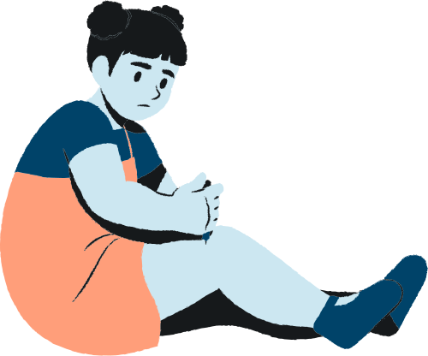
WHAT CAUSES HIGH BLOOD SUGAR LEVELS?
Explain the causes of high blood sugar levels.

Slide 21
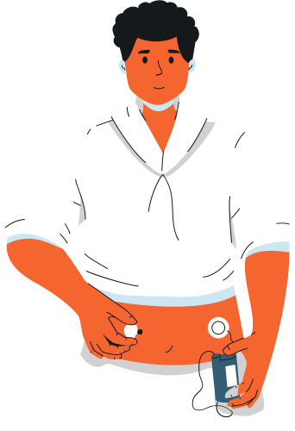
WHAT SHOULD BE YOUR IDEAL BLOOD SUGAR LEVEL?
Elaborate on the ideal blood sugar level.

Slide 22



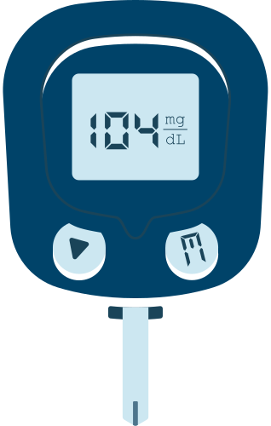
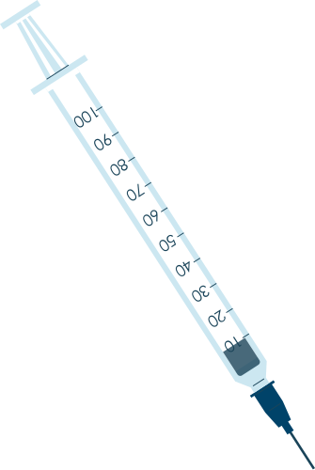

WHEN SHOULD YOU DO YOUR BLOOD TESTS?
Explain when to take blood tests.

Slide 23



WHAT TYPE OF DIET SHOULD YOU EAT?
Explain the type of diet that people
with diabetes should eat.

Slide 24


Slide 25
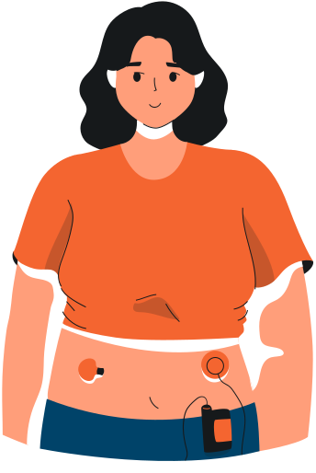
WHAT TYPES OF MEDICATION WILL
YOU NEED?
Explain the type medications for people with diabetes.

Slide 26
THANK YOU!
Thank you so much for watching our presentation! Do you have any questions, comments, or suggestions?

Slide 27

GET IN TOUCH
WEBSITE:
reallygreatsite.com
EMAIL ADDRESS:
hello@reallygreatsite.com
SOCIAL MEDIA:
@reallygreatsite
CONTACT NUMBER:
+123-456-7890

